Slide 1
To improve obesity based on big data personalized intelligent cooperative game
WHERE EVERY STEP COUNTS
Team Name: i++
Advisor: JunHwan Jang
Team Member
YunHui Kim
Yeeun Kim
SeongHyun Roh
JiWoong Choi

Slide 2
Overview
Background
Main Features
System Architecture
Data Architecture
Development Environments
Implementation Results & Demo
Conclusions and Future works
References
Table of contents

Slide 3
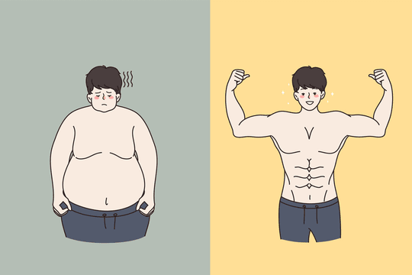
Overview
Have you ever been on a diet?
On a diet requires a strong will, so if you have experience in dieting, it is very difficult to go on a diet alone, so you can give up easily.
In addition, there are many healthcare apps on the market now, but there are no game-type apps.
Plus, there are no game-type apps can play with others.
Work out with others is the efficient way to lose weight, but it is not easy to recruit people around to go on a diet together.
So, you can easily recruit participants and compete against each other to quantify your lifestyle, which will increase engagement.

Slide 4
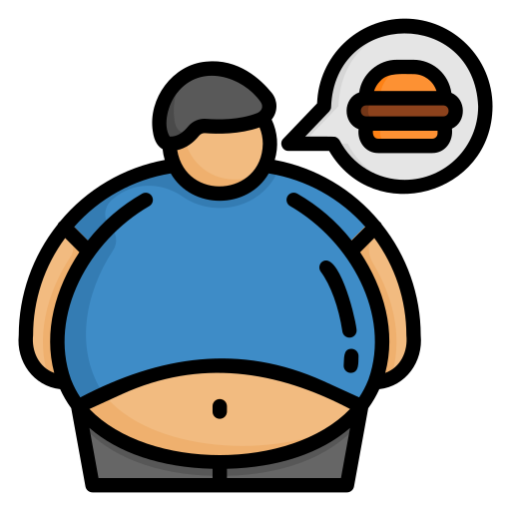

Background
WHO defines obesity as
: “A condition in which there is an abnormal or excessive accumulation of fat in adipose tissue to the extent that it is detrimental to health."
Obesity is the cause of various adult diseased, so treatment and prevention are essential

Slide 5
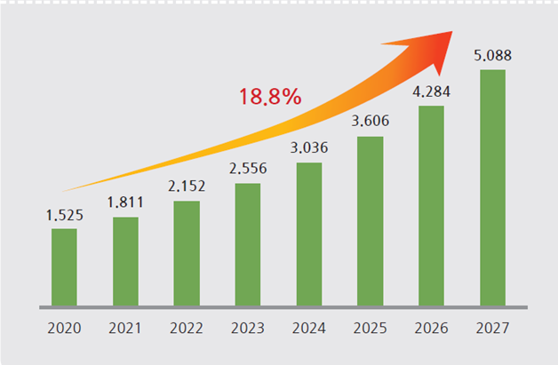


Background
Healthcare market is estimated to grow by around 20% annually and will reach about 508 billion dollars by 2027.
* Global Industry Analysts, “Digital Health: Global Market Trajectory&Analytics,” 2020.
noom: Helps users lose weight by providing them with the right diet and missions through conversations with a coach.
DSAHIN: It provides comprehensive information about diets and gives users diet tips when logging their workouts and meals.

Slide 6

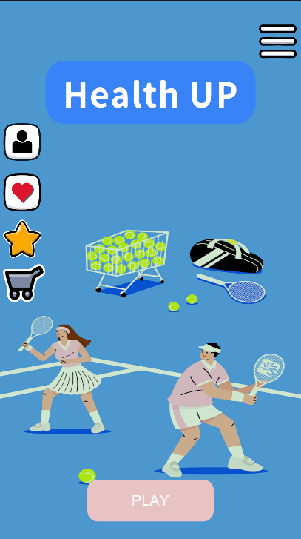
Background
Why we developed new service
A common weakness is on a diet that’s “Alone“
The problem with existing services is that you can easily give up on a diet at any time without any external factors
So, we create a ‘Team-game’ to on a diet with others
This game gives responsibility on team and reward from achieving goals to ensure users can have sustainable diet habits

Slide 7
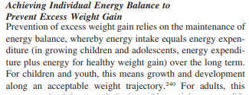
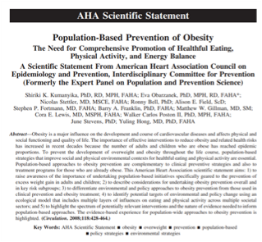
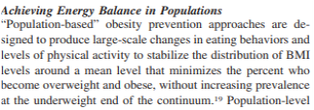
Related Research
The result of exercising alone
Professor Siriki Kumanika's team
Medical University of Pennsylvania
Exercise achievement results when working out together

Slide 8
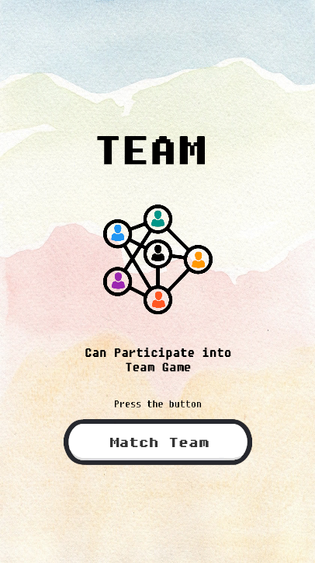
Main Features
Scene | Detailed Function | Screen Example
Main scene | • Can play the game by pressing various buttons • Check user’s health information and personal missions by pressing the challenge button • Join into team games by pressing the ‘PLAY’ button
Challenge list scene | • Can check given challenges during a game or diet to user
Team recruit scene | • During a given team recruitment period, user can form a group with our acquaintances through friending or form a team through randomization

Slide 9
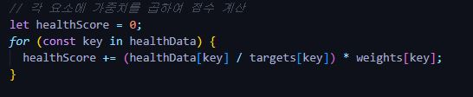
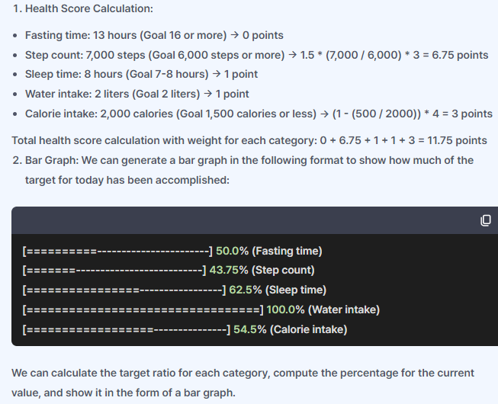
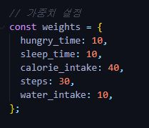
Main Features
Today's Health Score Calculation Algorithm | Screen Example
let healthScore = 0; for (const key in healthData) { healthScore += (healthData[key] / targets[key]) * weights[key];
hungry_time: 10, sleep_time: 10, calorie_intake: 40, steps: 30, water_intake: 10,

Slide 10
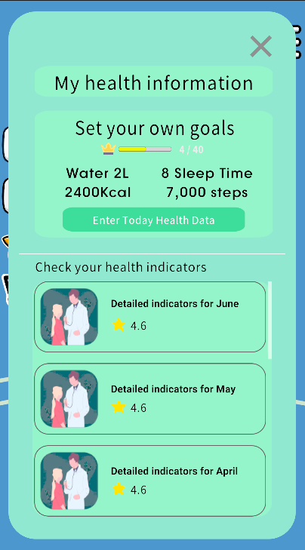
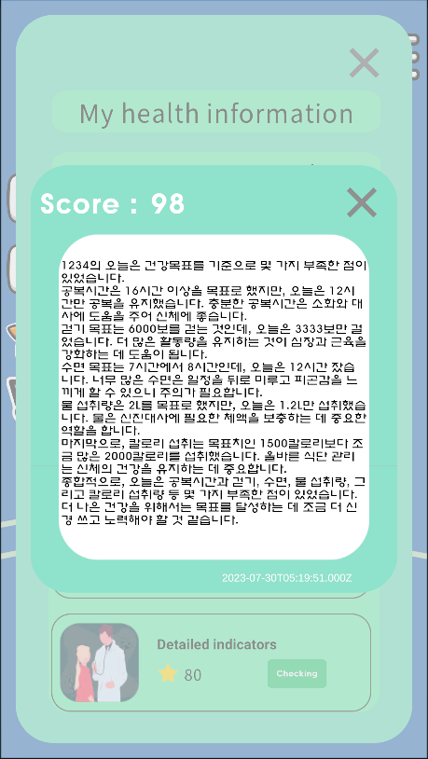
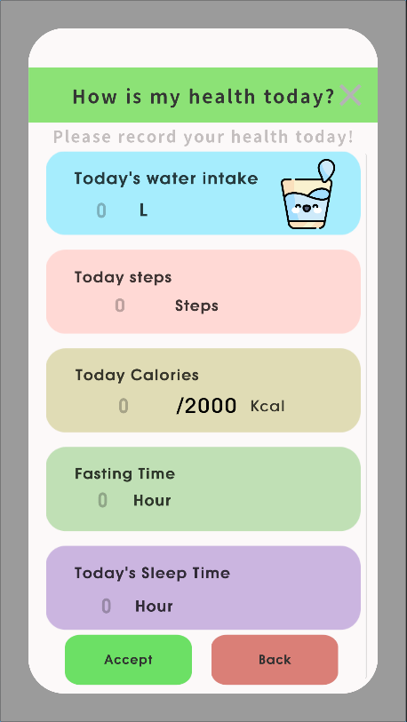
Main Features
Scene | Detailed Function | Screen Example
My health information scene | • Set user’s own health goals and check daily to how you're doing. • View health metrics that analyze user’s goals and performance each month.
Today's health status input scene | • Log water intake, steps per day, meals, fasting time, sleeping hours, and more on a daily basis.

Slide 11
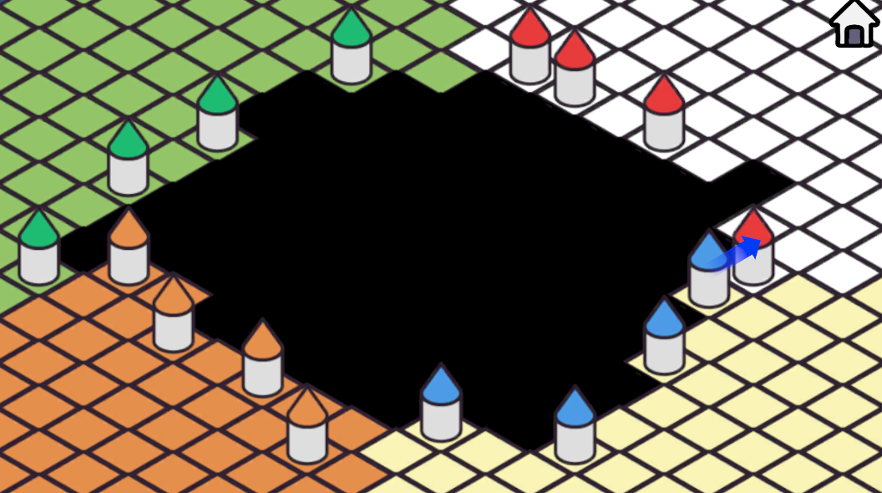
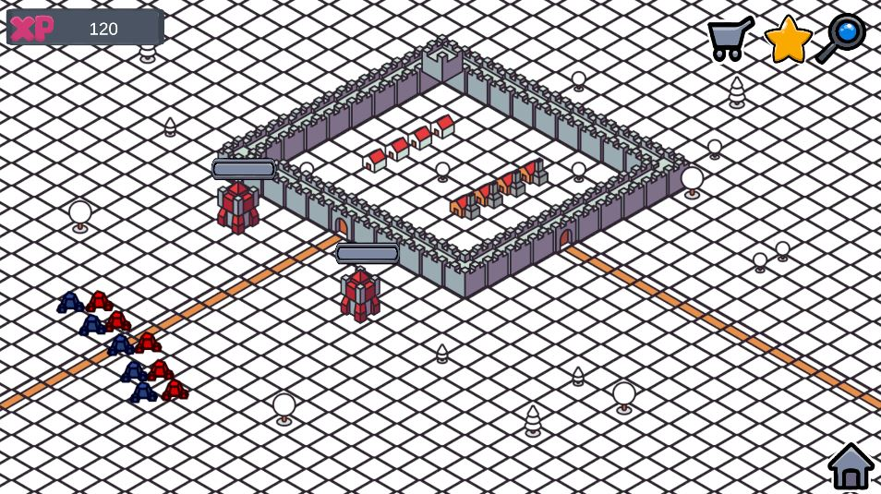
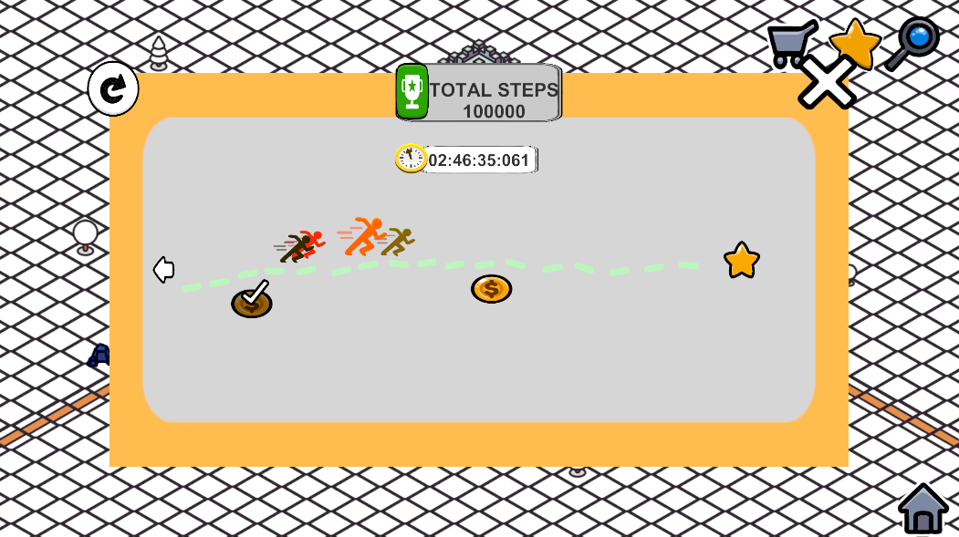
Main Features
Scene | Detailed Function | Screen Example
Team game (Siege) scene | • Each team have their own territory • Teams have 2 weeks to follow the rules of the game, to achieve their goals • The more team members who achieve their goals, the stronger the team becomes, and each day they can compete with neighboring teams to take more territories
Team unit challenge scene | • Teams can see the progress of a given mission in real time • Check team members' contributions

Slide 12
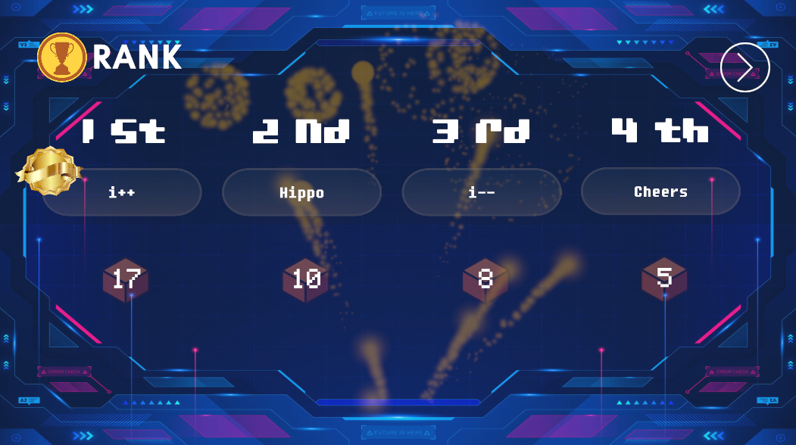
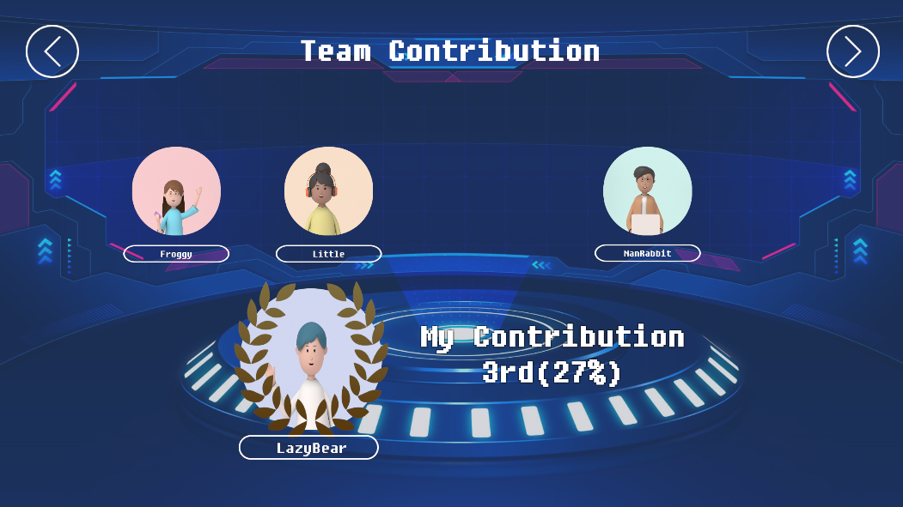
Main Features
Scene | Detailed Function | Screen Example
Ranking scene for each team after the siege | • Depending on the resulting ranking, user will receive badges or achievement titles. • Use the points you earn to decorate room or decorate user’s profile.
Post-siege team contribution scene | • At the end of the competition, points are awarded in the order of teams with the largest territories. • These are in turn distributed equally among team members, and contributions to the team are only visible to the individual, encouraging continued engagement.

Slide 13
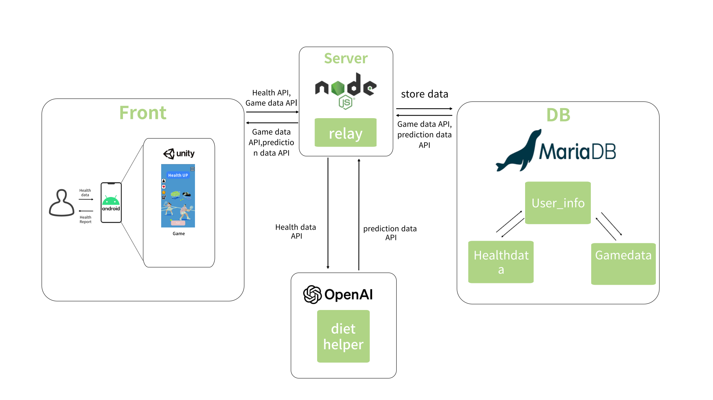

System Architecture

Slide 14
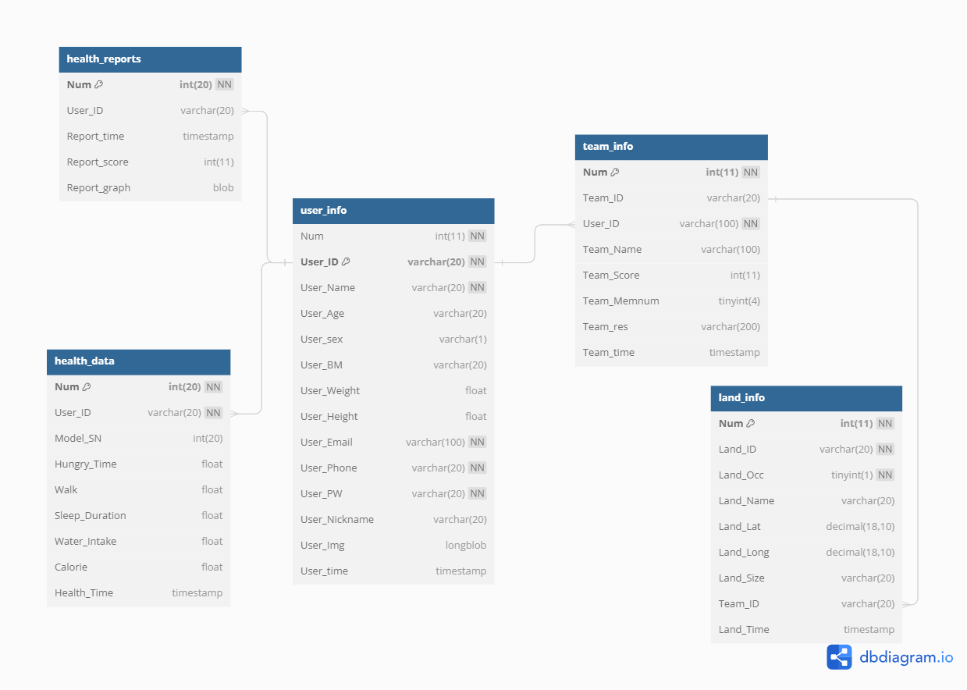
Data Architecture

Slide 15





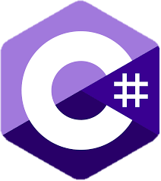




Development Environments
Game Engine | Database | AI Model
Server | Operating System | Language
Development OS | DVCS Tool

Slide 16
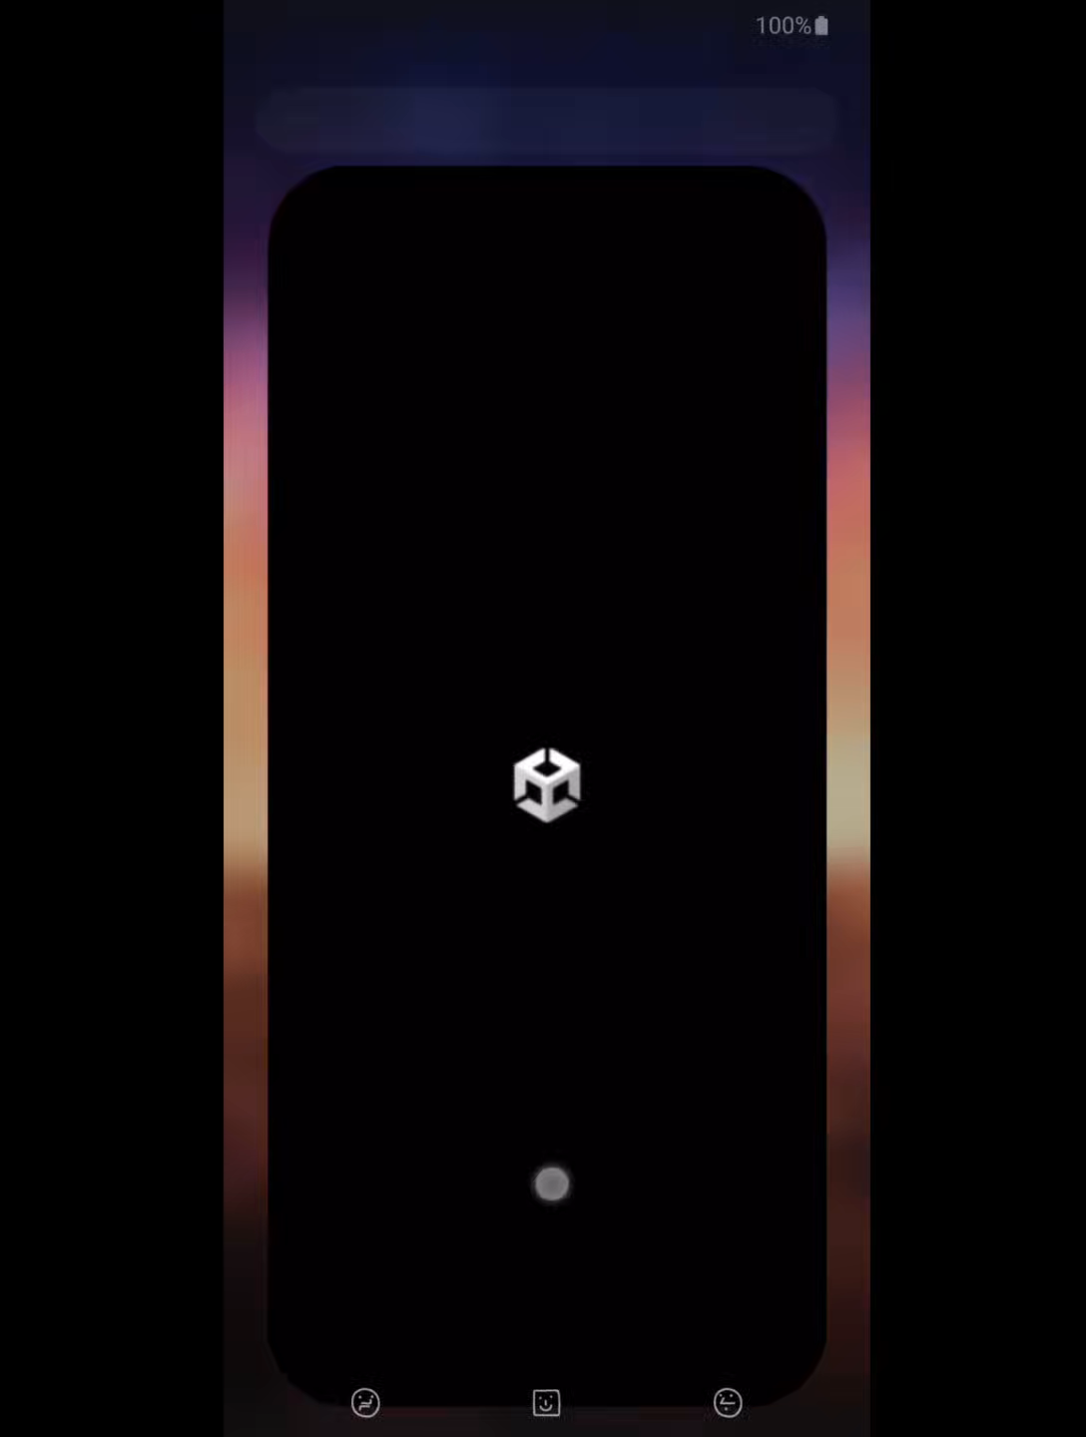
Implementation Results & Demo
GitHub address: https://github.com/iccas-i/game_client.git

Slide 17
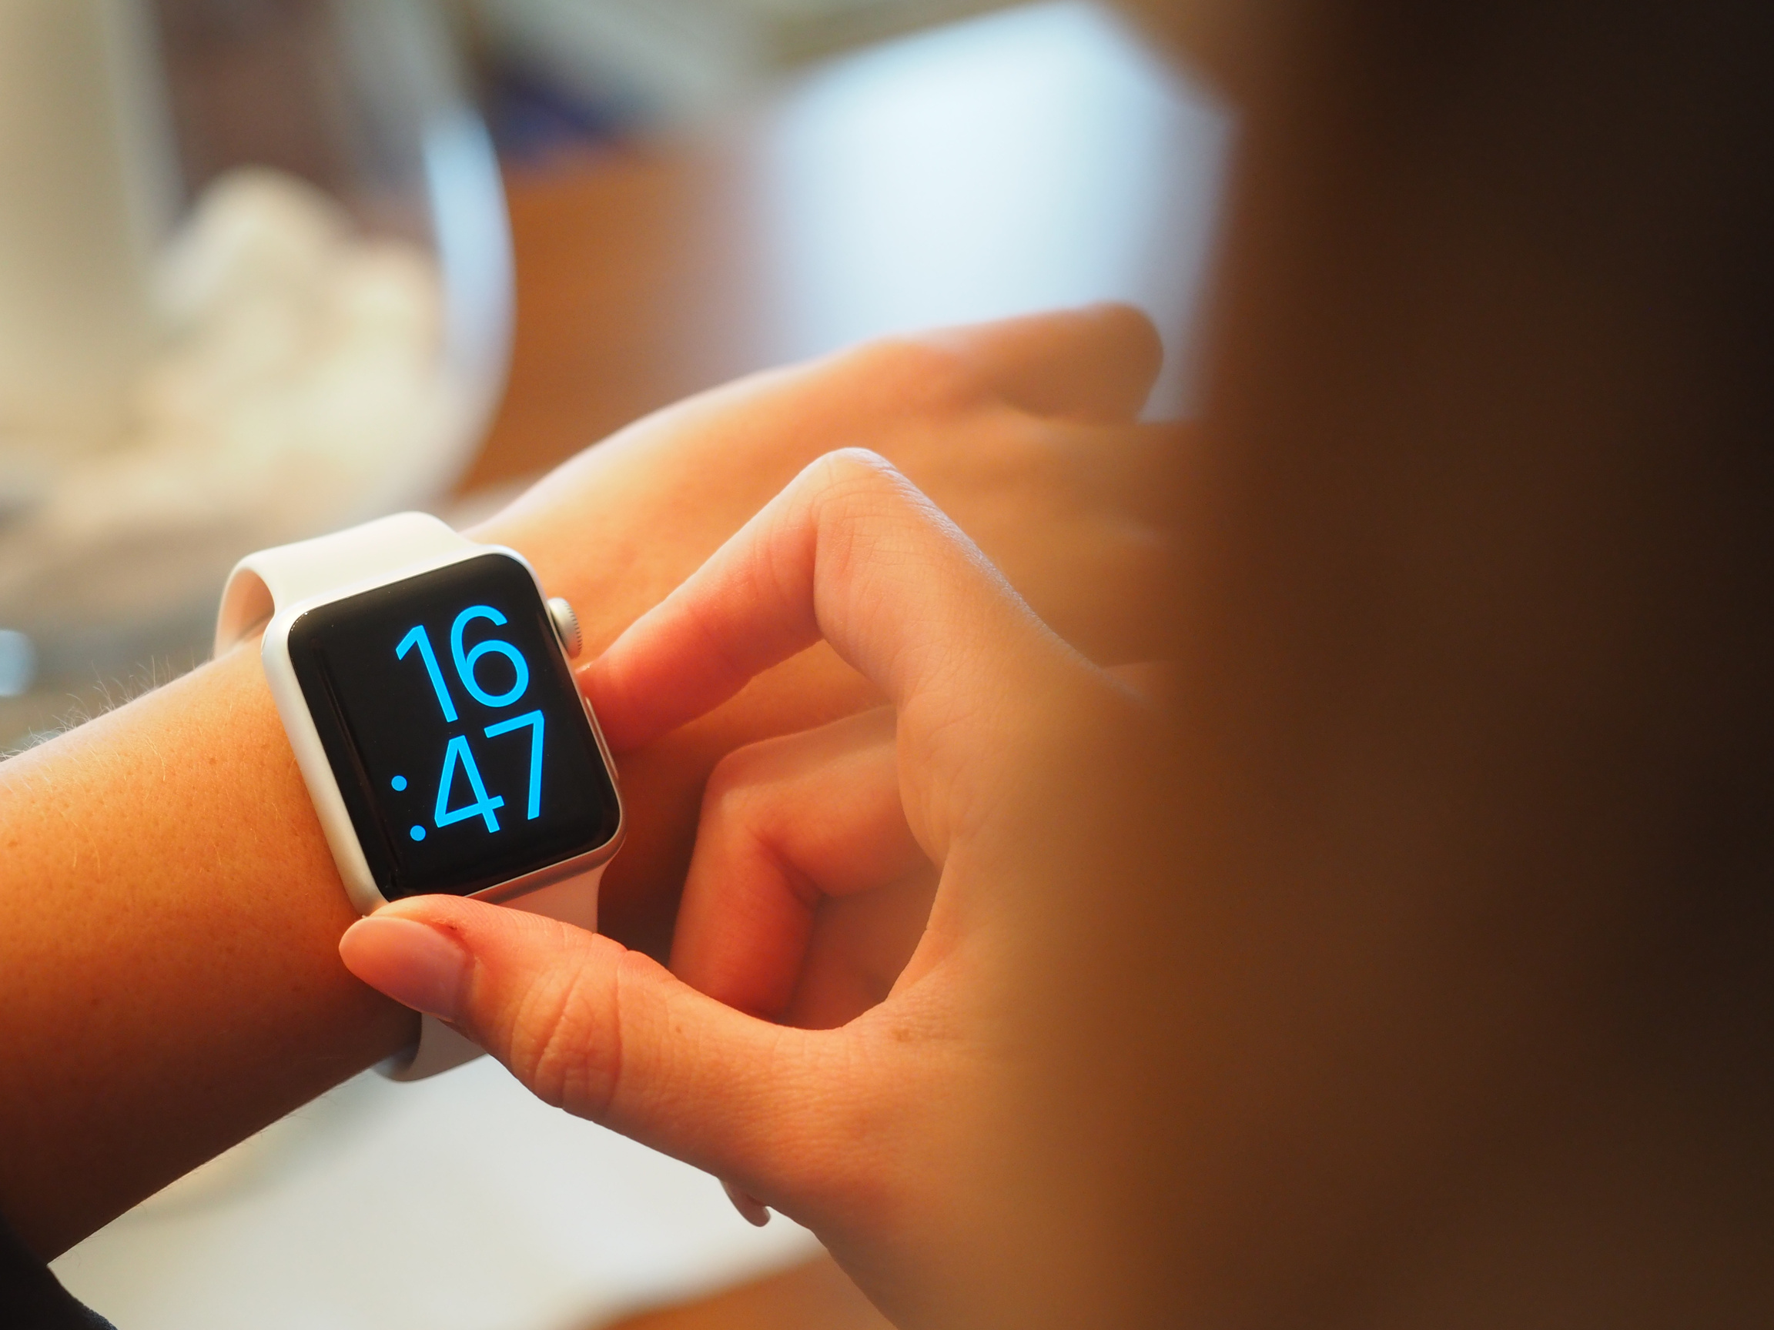
Conclusions and Future works
Motivation and satisfaction from the team game
Stress reduction and have healthy mind
Make a sustainable dieting habit

Slide 18

Conclusions and Future works
PLAY NOW!
• Achieve your individual goals
• Create a more enjoyable and effective dieting with playing with your teammates.

Slide 19
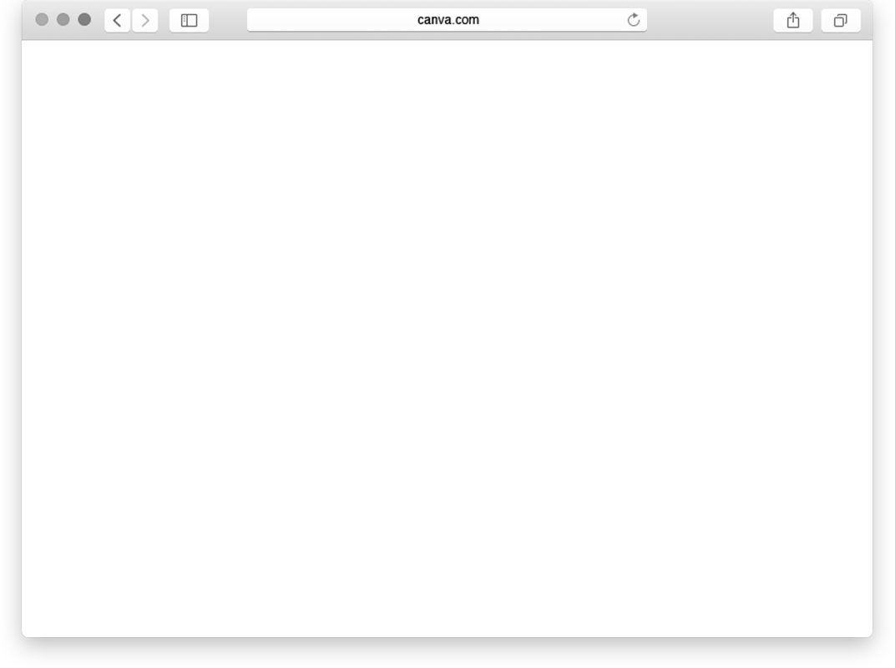

Conclusions and Future works
START RUNNING!
Improve and maintain users' healthy lifestyle habits through behavior modification
Obesity needs consistent and persistent healthy lifestyle
Our goal is to help people develop healthy lifestyle habits through dieting with others

Slide 20

Conclusions and Future works
What do we need to do next?
• Improve UI system, code refactoring
• Add avatar system
• Modify algorithm
• Learning AI model
• Add more game scenarios (Ex. Minigames)
• Develop personalized achieving system

Slide 21
References
Shiriki K. Kumanyika, Eva Obarzanek, Nicolas Stettler, Ronny Bell, Alison E. Field,Stephen P. Fortmann, Barry A. Franklin,Matthew W. Gillman,Cora E. Lewis,Walker Carlos PostonII, June Stevens and Yuling Hong(2008). Population-Based Prevention of Obesity, Circulation. 2008;118:428–464
CDC. 2022 Chronic Disease Status and Issues. 11-1790387-0000005-10
Soo-Hyun Lee, Mi-Joon Lee, Bum-Jeun Seo(2022). The Effect of Sleep Duration on Obesity in Korean Adults, Journal of convergence for Information Technology, 2586-4440
Yoo Jaeha, Won Sunghee, Lee Okhee. "Are you healthy, diet?" Student Life Study 16. - (2009): 101-114. Perception and status of diet among natural college students
Mi-JungPark(2006), (The) study on the relationship between obesity indices and risk factors of metabolic syndrome in Koreans
Palanica, A., Docktor, M. J., Lieberman, M., & Fossat, Y. (2020). The need for artificial intelligence in digital therapeutics. Digital Biomarkers, 4(1), 21-2
Irwin, Brandon C, Kerr, Norbert L. Wittenbaum, Gwen, Pontifex, Matthew B. (2012). Increasing physical activity in free-living conditions : an examination of the Kohler motivation gain effect, 97812673144131267314419
Beckles, Joelle A.(2017). Enhancing motivation to exercise for obese participants in exergames : testing partner characteristics as a moderator of the Kohler effect, 9780355224818035522481X

Slide 22
References
Tim Lobstein, Rachel Jackson-Leach, Jaynaide Powis, Hannah Brinsden and Maggie Gray , World Obesity Atlas Report (2023)

Slide 23
Thank you

